Slide 1
Automatic room light control using Arduino
Team members
M. Aravind - EDM18B036
G. Sai Kumar - ESD18I007
B. kiran - EVD18I029

Slide 2
OBJECTIVE
In recent years the people are looking forward for the automation in their day to day life
People are lazy to switch off the lights while leaving the room.
In public and private sector companies, offices most of the people are not interested to switch OFF
In this project we will see automatic room light control that will control the main switch, which will be turned on only if a person is detected.
It is based on IR sensor and Arduino Uno board.

Slide 3
RESEARCH PAPERS
RESEARCH-1
RESEARCH-2
RESEARCH-3
This paper proposed a system where IR beam as source and Arduino as controller
The System is based on the interruption of IR beam. An IR beam is used as the source of light beam.
Bidirectional Visitor Counter with Automatic Room Light Controller and Arduino as the master controller has two sections.
IN This paper they used Arduino and PIR sensor to develop automatic room light system as follows
PIR Sensor’s Data OUT Pin is connected to Arduino’s Digital I/O Pin 8. An LED is connected to pin 13 of Arduino to indicate whether the light is turned ON or OFF . The IN1 pin of the Relay Module is connected to Pin9 of Arduino. A bulb is connected to mains supply through relay.
IN This paper we came across ARM based automatic room light controller using PIR sensor
Microcontroller determines whether a visitor is coming in or going out by reading the output sequence of the two sensors. We will call the outside sensor Sensor-A and the inside sensor as Sensor-B The output of the microcontroller derives a relay circuit that turns on the lights of the room when the counter is incremented from 0.

Slide 4
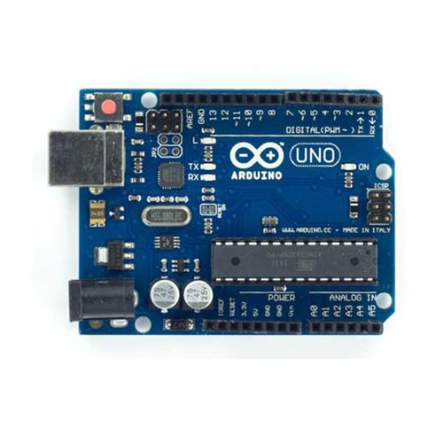
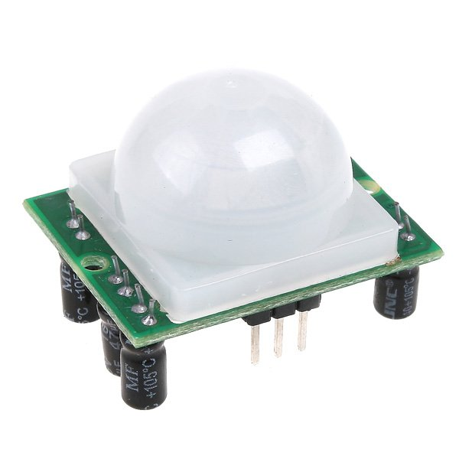
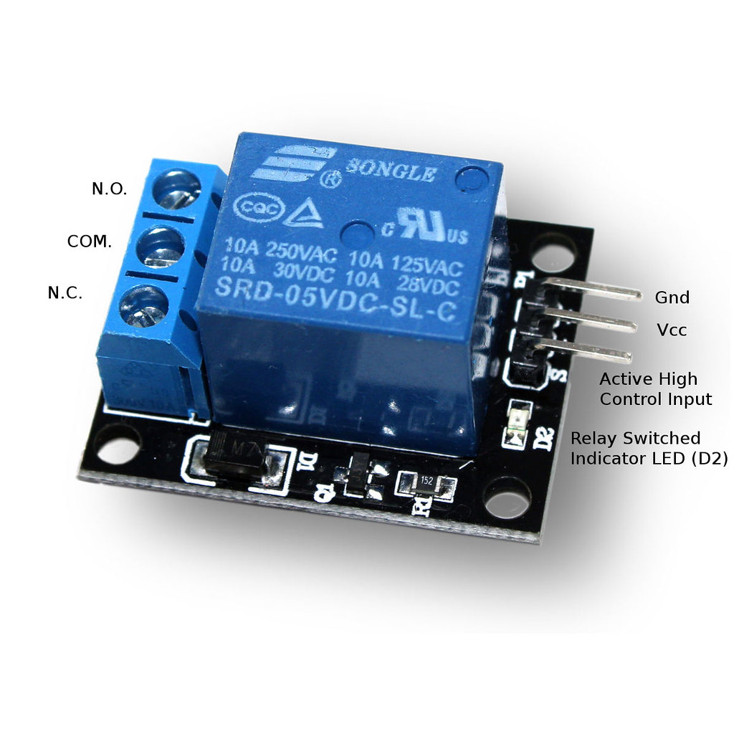
HARDWARE COMPONENTS
ARDUINO UNO
PIR SENSOR
RELAY MODULE
The Arduino Uno is an open source microcontroller board
A passive infrared sensor (PIR sensor) is an electronic sensor that measures infrared (IR) light radiating from objects in its field of view.
They are most often used in PIR-based motion detector. PIR sensors are commonly used in security alarms and automatic lighting applications.
This module contains two relays that are electrically isolated from the controlling input.
The relays can be used to switch higher voltage and current loads than a microcontroller can traditionally accomplish.
The board is equipped with sets of digital and analog input/output(I/O) pins that may be interfaced to various expansion boards (shields) and other circuits

Slide 5
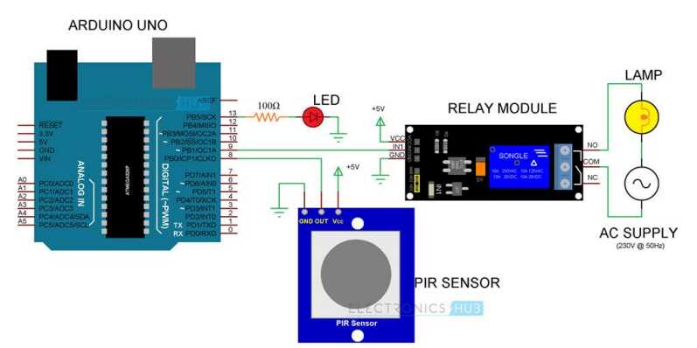
CIRCUIT

Slide 6


SOFTWARES USED

Slide 7
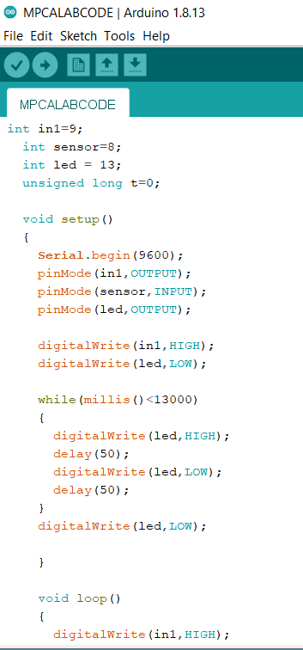

PROGRAMME CODE

Slide 8
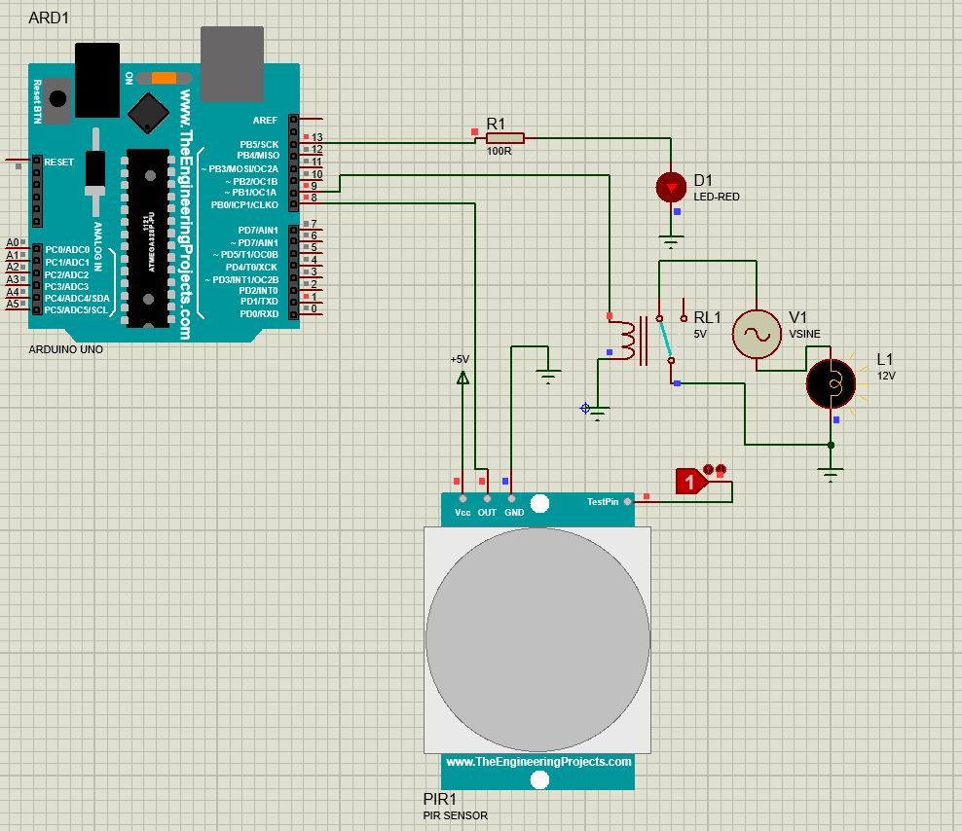
SIMULATION IN PROTEUS

Slide 9
THANK YOU

